Slide 1
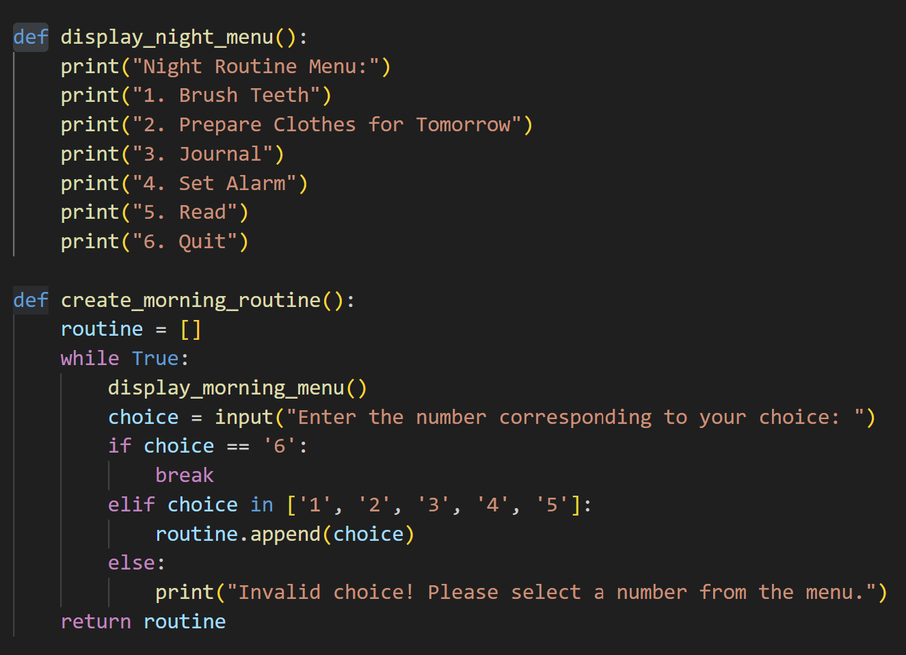
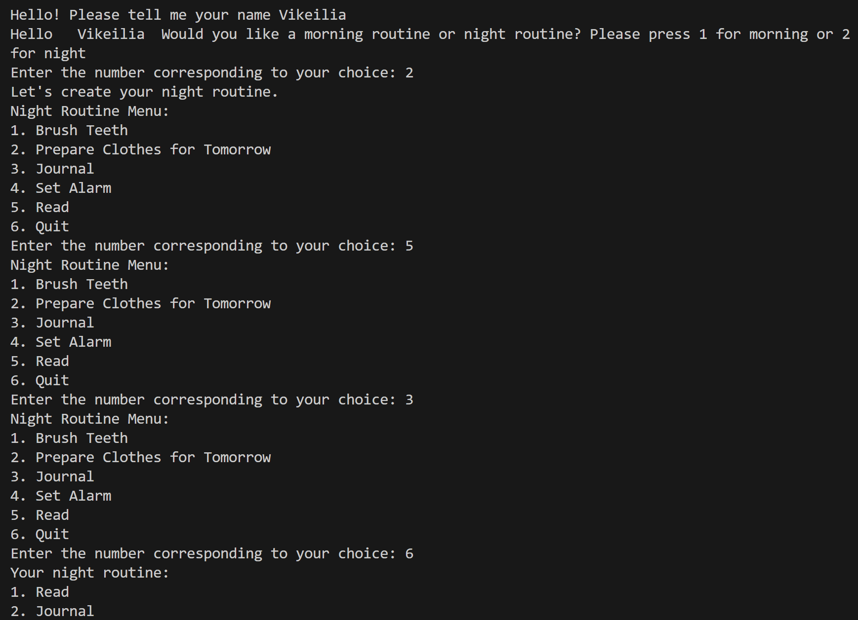

Easy Routine Vikeilia Pemberton-henry
https://github.com/ksu-is/morning-routines
Easy Routine is a way of making morning and night routines quick, easy, and fun. Take the guess work out of routine and live in your healthy era.

